Slide 1

TALKING CHALKS
Domiziana Catalano Edoardo Puglisi Gianluca Panici

Slide 2
IDEA
TalkingChalks is an IoT system that can be used in a museum. It can help visitors during the tour providing information about the museum, the statues and the story behind them.
A smartband with the most suitable profile will be provided to each visitor so that can everyone can have a personalized experience.

Slide 3
TALKING CHALKS
Domiziana Catalano Edoardo Puglisi Gianluca Panici

Slide 4
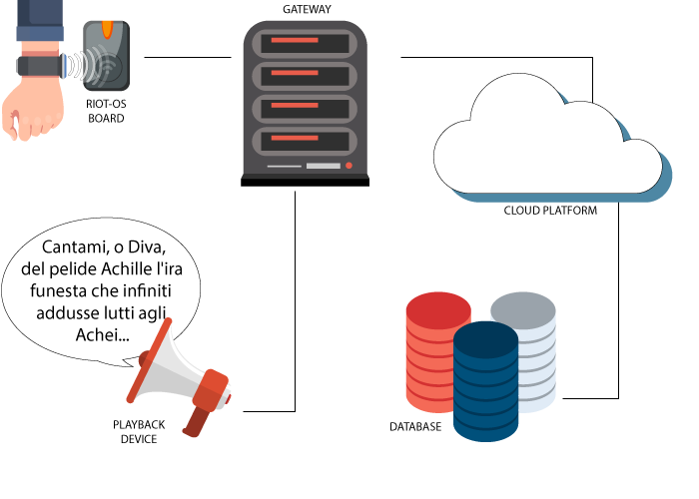
ARCHITECTURE
Riot-OS STM Nucleo Board with NFC/BEACON sensor
Gateway to the Cloud
Playback device for the customized experience
Cloud service for scaling
Database recording visitor presences

Slide 5
TALKING CHALKS
Domiziana Catalano Edoardo Puglisi Gianluca Panici

Slide 6



PERSONAS
Teacher and students
Foreign visitor
Fan of ancient history

Slide 7

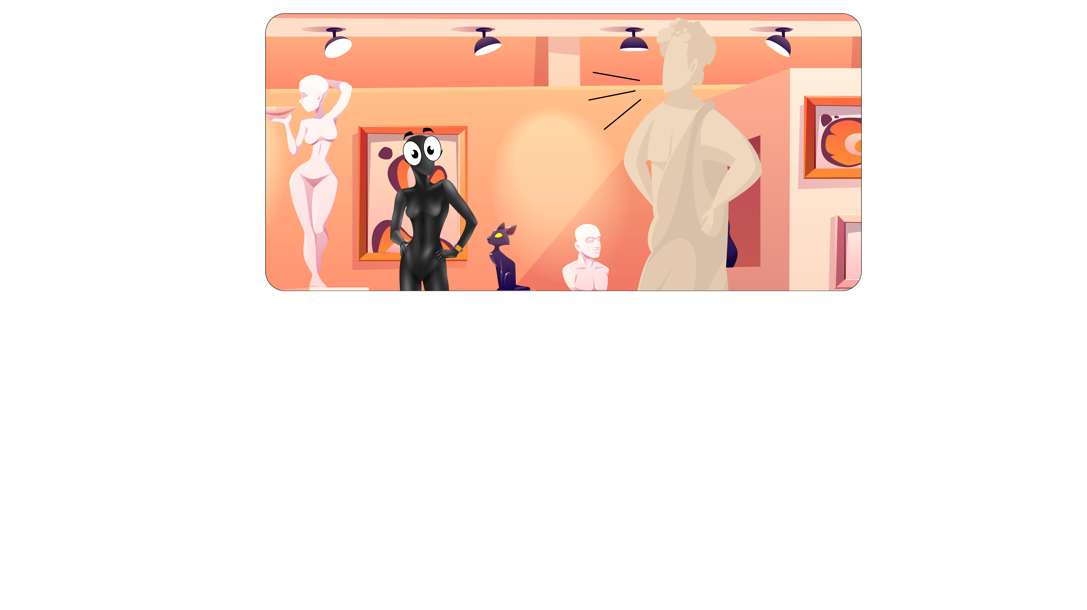
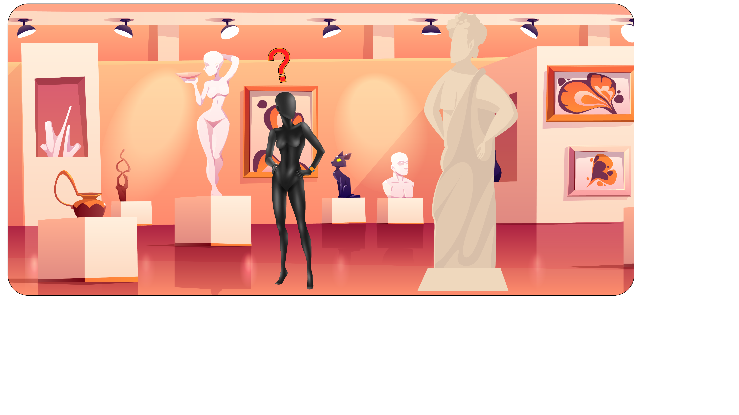
STORYBOARD
Visitor happy and stoned hearing talking figures
New amazing technology comes to help him
Visitor confused and afraid of his ignorance

Slide 8
THANKS FOR WATCHING
Domiziana Catalano Edoardo Puglisi Gianluca Panici

